Slide 1


FAKE NEWS DETECTION SYSTEM USING MACHINE LEARNING
GROUP MEMBERS :-
SYED SAIFUDDIN CSE-A 160317733018
ATIF ALI KHAN CSE-A 160317733025
MOHD MISBAH UDDIN CSE-A 160317733036

Slide 2
Introduction:
Fake news is where individuals or organisations intentionally publish hoaxes, propaganda and other misinformation and present it as factual.
This can include blog and social media posts and fake online media releases.
It also does not include articles that are written from the perspective of a particular opinion or editorial standpoint, provided the information included is factually correct.
Fake news and lack of trust in the media are growing problems with huge ramifications in our society.

Slide 3
These days’ fake news is creating different issues from sarcastic articles to a fabricated news and plan government propaganda in some outlets.
Obviously, a purposely misleading story is “fake news “ but lately blathering social media’s discourse is changing its definition. Some of them now use the term to dismiss the facts counter to their preferred viewpoints.
The term 'fake news' became common parlance for the issue, particularly to describe factually incorrect and misleading articles published mostly for the purpose of making money through page views. In this paper,it is seeked to produce a model that can accurately predict the likelihood that a given article is fake news.
However, in order to solve this problem, it is necessary to have an understanding on what Fake News is.
Later, it is needed to look into how the techniques in the fields of machine learning, natural language processing help us to detect fake news.

Slide 4
Applications:
Classification of the fake news
Image reconition
Speech recognition
Traffic prediction
Fraud detection
Intelligent agents
Natural language processing
Supervised learning
Unsupervised learning

Slide 5
Advantages:
The easy access and exponential growth of the information available on social media networks has made it inticate to distinguish between false and true information
The easy dissemination of information by way of sharing has added to exponential growth of its falsification.
The credibility of social media networks i also at stake where the spresading of fake information is prevalent
Thus it has bacome a research challenge to automatically check the information viz a viz it source, content and publisher for categorizing it as false or true.
machine learning has played a vital role in classification of the information although with some limitations.

Slide 6
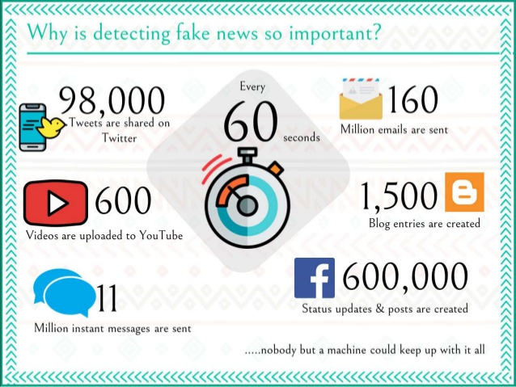
Issues/Challenges:

Slide 7
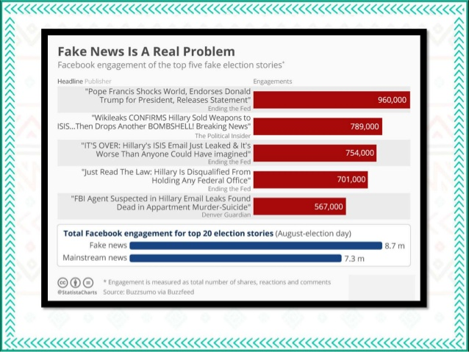

Slide 8


Slide 9
SURVEY/EXISTING SYSTEM:
There exists a large body of research on the topic of machine learning methods for deception detection, most of it has been focusing on classifying online reviews and publicly available social media posts.
Conroy, Rubin, and Chen [1] outlines several approaches that seem promising towards the aim of perfectly classify the misleading articles. They note that simple content-related n-grams and shallow parts-of-speech (POS) tagging have proven insufficient for the classification task, often failing to account for important context information.
Rather, these methods have been shown useful only in tandem with more complex methods of analysis.
Deep Syntax analysis using Probabilistic Context Free Grammars (PCFG) have been shown to be particularly valuable in combination with n-gram methods. Feng and Hirst implemented a semantic analysis looking at 'object:descriptor' pairs for contradictions with the text on top of Feng's initial deep syntax model for additional improvement. Rubin, Lukoianova and Tatiana analyze rhetorical structure using a vector space model with similar success. Ciampaglia et al. employ language pattern similarity networks requiring a pre-existing knowledge base.

Slide 10
In [1], Shloka Gilda presented concept approximately how NLP is relevant to stumble on fake information. They have used time period frequency-inverse record frequency (TFIDF) of bi-grams and probabilistic context free grammar (PCFG) detection. They have examined their dataset over more than one class algorithms to find out the great model.They locate that TF-IDF of bi-grams fed right into a Stochastic Gradient Descent model identifies non-credible resources with an accuracy of seventy seven.2%.
In [2], Mykhailo Granik proposed simple technique for fake news detection the usage of naive Bayes classifier. They used BuzzFeed news for getting to know and trying out the NaïveBayes classifier. The dataset is taken from facebook newspublish and completed accuracy upto seventy four% on test set.
In [3], Cody Buntain advanced a method for automating fakenews detection on Twitter. They applied this method toTwitter content sourced from BuzzFeed’s fake news dataset.Furthermore, leveraging nonprofessional,crowdsourced people instead of journalists presents a beneficial and muchless costly way to classify proper and fake memories onTwitter rapidly.
In [4], Marco L. Della offered a paper which allows us to recognize how social networks and gadget studying (ML)strategies may be used for faux news detection .They have used novel ML fake news detection method and carried out this approach inside a Facebook Messenger chatbot and established it with a actual-world application, acquiring a fake information detection accuracy of eighty one.7%.

Slide 11
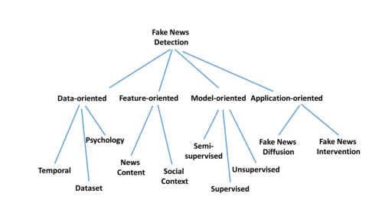
Different approaches to fake news detection

Slide 12
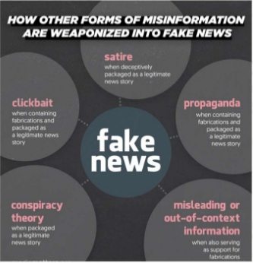
Problem Statement:

Slide 13


HARDWARE REQUIREMENTS
Physical server or virtual machine.
CPU: 2 x 64-bit, 2.8 GHz, 8.00 GT/s CPUs or better.
Memory: minimum RAM size of 32 GB, or 16 GB RAM with
1600 MHz DDR3 installed, for a typical installation with 50 regular users
Storage: Recommended minimum of 100 GB, or 300 GB
Internet access to download the files
SOFTWARE REQUIREMENTS
Python (Minimum version 3.7.x)
Anaconda Package
Google Chrome
Xampp (For executing PHP files)
HTML5
Operating systems: Windows* 7 or later, macOS, and Linux

Slide 14
PROPOSED SYSTEM
The proposed system will make use of the following algorithms and modules :-
Pickle
Flask App
Newspaper3K Library
TF-IDF
Multinomial Naïve Baiyes

Slide 15

PICKLE
The pickle module implements binary protocols for serializing and de-serializing a Python object structure.
Pickling” is the process whereby a Python object hierarchy is converted into a byte stream, and “unpickling” is the inverse operation, whereby a byte stream (from a binary file or bytes-like object) is converted back into an object hierarchy.
Warning
The pickle module is not secure. Only unpickle data you trust.
It is possible to construct malicious pickle data which will execute arbitrary code during unpickling. Never unpickle data that could have come from an untrusted source, or that could have been tampered with.

Slide 16
What can be pickled and unpickled?
The following types can be pickled:
None, True, and False
integers, floating point numbers, complex numbers
strings, bytes, bytearrays
tuples, lists, sets, and dictionaries containing only picklable objects
functions defined at the top level of a module (using def, not lambda)
built-in functions defined at the top level of a module
classes that are defined at the top level of a module
instances of such classes whose __dict__ or the result of calling __getstate__() is picklable (see section Pickling Class Instances for details).

Slide 17

FLASK APP
It is a Web Server Gateway Interface (WSGI) web application framework designed to create web apps.
It is passed the name of the module or package of the application. Once it is created it will act as a central registry for the view functions, the URL rules, template configuration and much more.
Usually you create a Flask instance in your main module or in the __init__.py file of your package like this:
from flask import Flask
app=Flask(_name_)

Slide 18
Newspaper3k Library
The Newspaper3k package is a Python library used for Web Scraping articles, It is built on top of requests and for parsing lxml.
This module is a modified and better version of the Newspaper module which is also used for the same purpose.
To install this module type the below command in the terminal.
pip install newspaper3k

Slide 19

Features :-
Multi-threaded article download framework
News url identification
Text extraction from html
Top image extraction from html
All image extraction from html
Keyword extraction from text
Summary extraction from text
Author extraction from text
Google trending terms extraction
Works in 10+ languages (English, Chinese, German, Arabic, …)

Slide 20
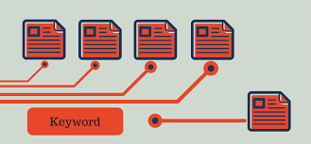
TF-IDF
Term Frequency-Inverse Document Frequency is a numerical statistic that is intended to reflect how important a word is to a document in a collection or corpus
The tf–idf value increases proportionally to the number of times a word appears in the document and is offset by the number of documents in the corpus that contain the word, which helps to adjust for the fact that some words appear more frequently in general. tf–idf is one of the most popular term-weighting schemes today
A survey conducted in 2015 showed that 83% of text-based recommender systems in digital libraries use tf–idf

Slide 21
Multinomial Naive Bayes
Naive Bayes is based on Bayes’ theorem, where the adjective Naïve says that features in the dataset are mutually independent
Occurrence of one feature does not affect the probability of occurrence of the other feature.
For small sample sizes, Naïve Bayes can outperform the most powerful alternatives.
Being relatively robust, easy to implement, fast, and accurate, it is used in many different fields.
Multinomial Naive Bayes relies on very simple representation of document as a ‘Bag of words’.
The multinomial Naive Bayes classifier is suitable for classification with discrete features (e.g., word counts for text classification).
The multinomial distribution normally requires integer feature counts. However, in practice, fractional counts such as tf-idf may also work

Slide 22

Advantages:
Low computation cost.
It can effectively work with large datasets.
For small sample sizes, Naive Bayes can outperform the most powerful alternatives.
Easy to implement, fast and accurate method of prediction.
Can work with multiclass prediction problems.
It performs well in text classification problems.
Applications:
Naive Bayes classifier is used in Text Classification, Spam filtering and Sentiment Analysis. It has a higher success rate than other algorithms.
Naïve Bayes along with Collaborative filtering are used in Recommended Systems.
It is also used in disease prediction based on health parameters.
This algorithm has also found its application in Face recognition.
Naive Bayes is used in prediction of weather reports based on atmospheric conditions (temp, wind, clouds, humidity etc.)

Slide 23

DESIGN
Front End :-
The part of a website that user interacts with directly is termed as front end.
It is also referred to as the ‘client side’ of the application
The Front End of our project is designed using
HTML
CSS
JavaScript
Back End :-
It is the portion of software that does not come in direct contact with the users.
Backend is server side of the website.
The Back End of our project is designed using
Python
PHP

Slide 24
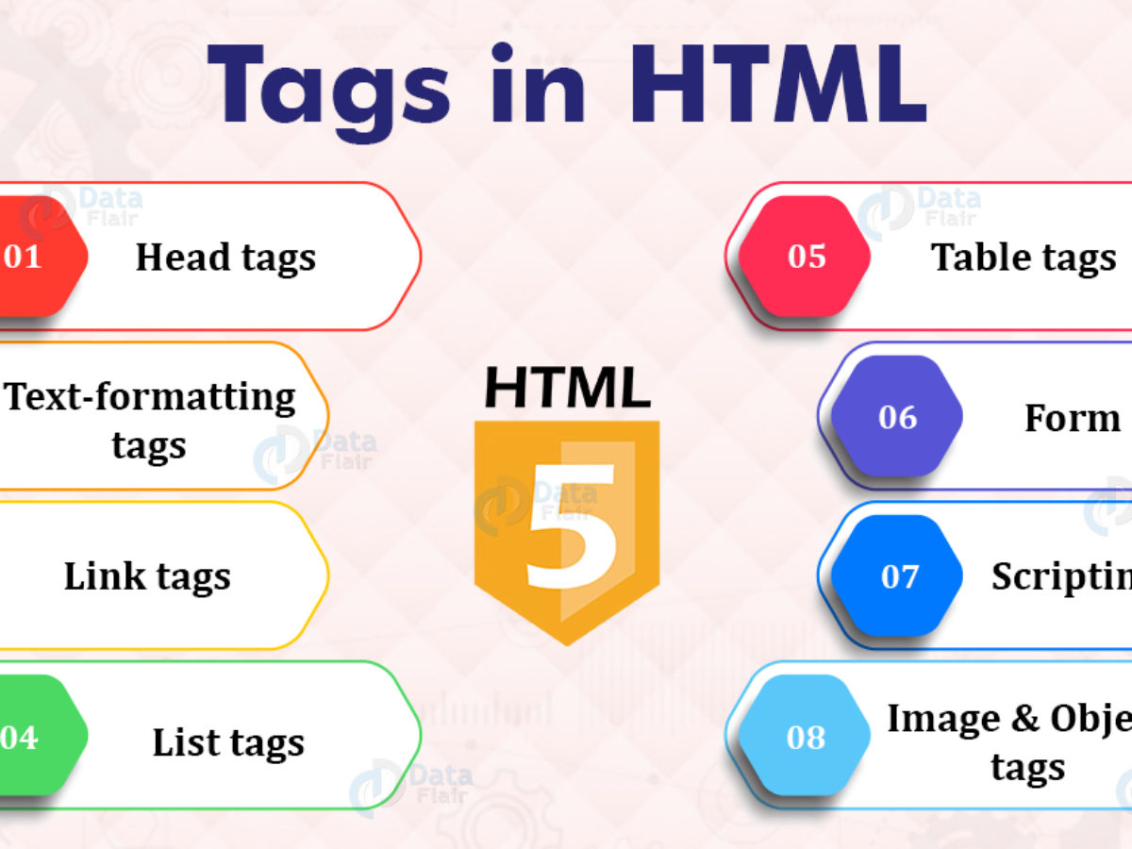

HTML(HYPER TEXT MARKUP LANGUAGE)
Hypertext Markup Language (HTML) is the standard markup language for documents designed to be displayed in a web browser
It can be assisted by technologies such as Cascading Style Sheets (CSS) and scripting languages such as JavaScript.
HTML describes the structure of a web page semantically and originally included cues for the appearance of the document.
HTML documents are saved with the “.html” or the “.htm” extension

Slide 25

CSS (Cascading Style Sheets)
Cascading Style Sheets (CSS) is a style sheet language used for describing the presentation of a document written in a markup language such as HTML
CSS is a cornerstone technology of the World Wide Web, alongside HTML and JavaScript.
CSS is designed to enable the separation of presentation and content, including layout,colours and fonts.
The CSS files are saved with the “.css” extension

Slide 26

JavaScript
JavaScript ("JS" for short) is a full-fledged dynamic programming language that can add interactivity to a website.
It was invented by Brendan Eich (co-founder of the Mozilla project, the Mozilla Foundation, and the Mozilla Corporation).
JavaScript is high-level, often just-in-time compiled, and multi-paradigm language
JavaScript files are saved with the “.js” extension
JavaScript can be embedded into an HTML document by using the <script> tag

Slide 27

Python
Python is an interpreted, high-level and general-purpose programming language.
Python's design philosophy emphasizes code readability with its notable use of significant whitespace.
It’s language constructs and object-oriented approach aim to help programmers write clear, logical code for small and large-scale projects
Python is dynamically typed and garbage-collected.
It supports multiple programming paradigms including structured (particularly, procedural), object-oriented, and functional programming
Python is often described as a "batteries included" language due to its comprehensive standard library

Slide 28

PHP (PHP: Hypertext Preprocessor)
PHP is a general-purpose scripting language especially suited to web development.
It was originally created by Danish-Canadian programmer Rasmus Lerdorf in 1994
PHP originally stood for Personal Home Page but it now stands for the recursive initialism PHP: Hypertext Preprocessor
PHP code is usually processed on a web server by a PHP interpreter implemented as a module, a daemon or as a Common Gateway Interface (CGI) executable.

Slide 29

Why PHP?
PHP runs on various platforms (Windows, Linux, Unix, Mac OS X, etc.)
PHP is compatible with almost all servers used today (Apache, IIS, etc.)
PHP supports a wide range of databases
PHP is free. Download it from the official PHP resource: www.php.net
PHP is easy to learn and runs efficiently on the server side
What Can PHP Do?
PHP can generate dynamic page content
PHP can create, open, read, write, delete, and close files on the server
PHP can collect form data
PHP can send and receive cookies
PHP can add, delete, modify data in your database
PHP can be used to control user-access
PHP can encrypt data

Slide 30
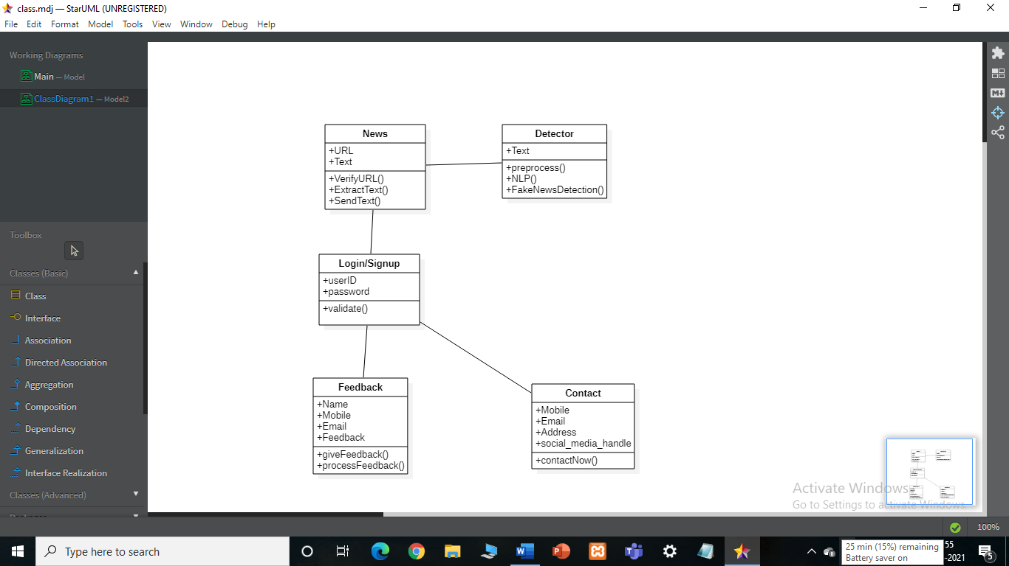
Class Diagram:

Slide 31
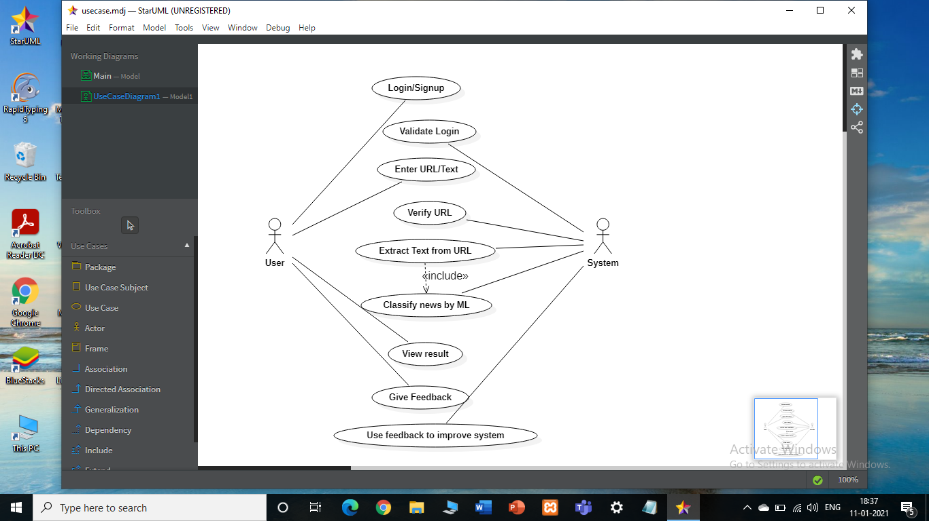
Usecase diagram:

Slide 32
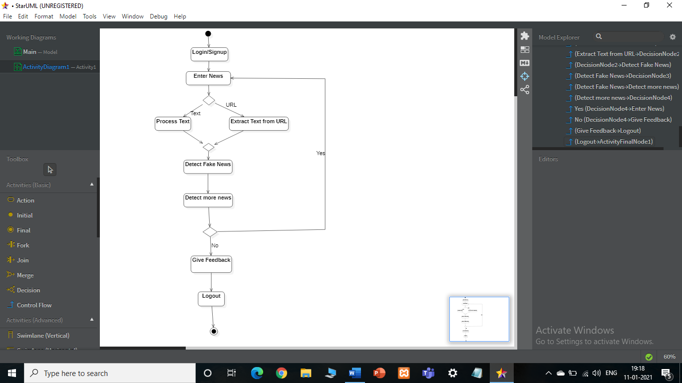
Activity Diagram:

Slide 33
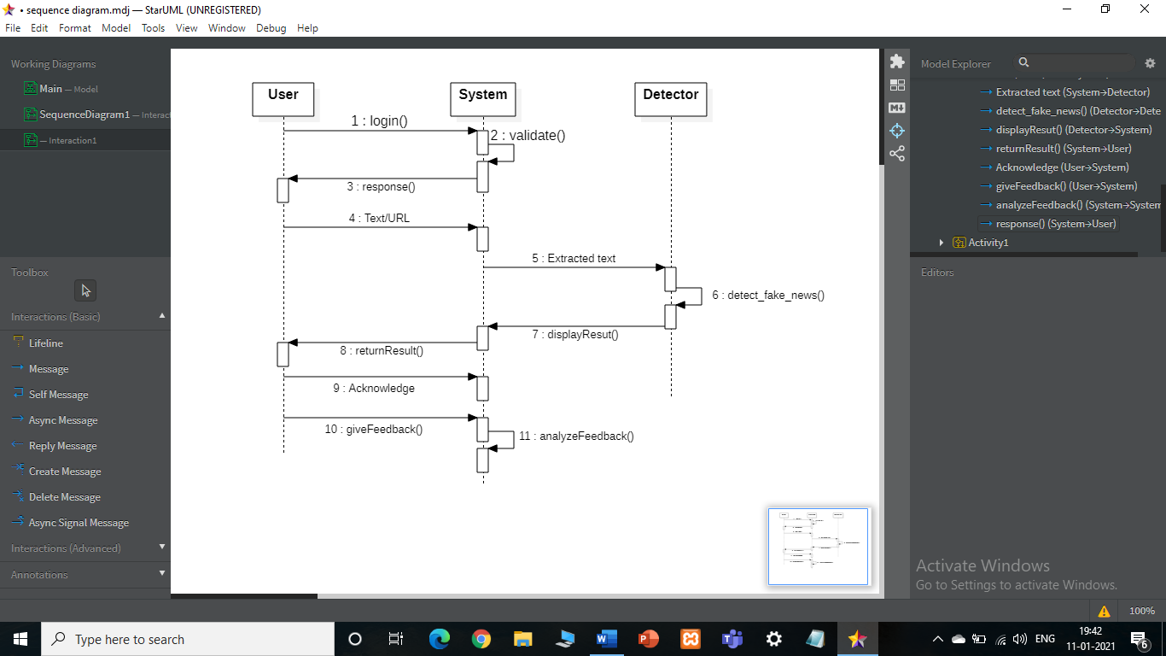
Sequence Diagram:

Slide 34
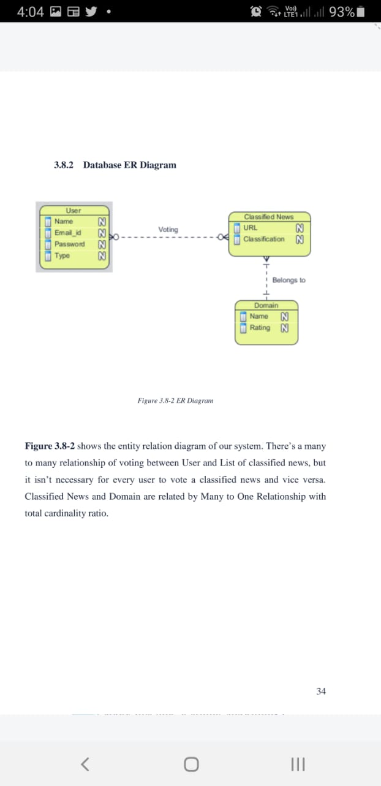

Slide 35
